Slide 1
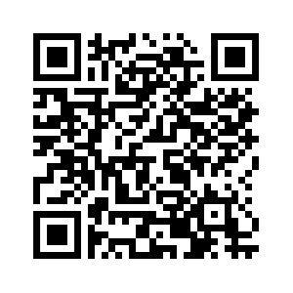
CropTalk
Webinar Series
Broadcast Live from 12:00 – 1:00 pm CT
via Zoom and YouTube
February 20
Management Tactics for Wheat Production
Romulo Lollato, K-State Wheat Specialist
February 27
Biological Products and Their Role in Soil Fertility
Dave Franzen, North Dakota State Soil Specialist
March 5
Managing Areas of Fields with High pH
Dorivar Ruiz Diaz, K-State Soil Fertility Specialist
March 12
Fallow Replacement Options in Dryland Rotations
Lucas Haag, K-State Northwest Area Agronomist
Register to attend at www.northwest.ksu.edu/events
Links for joining will be sent after registration.
Certified Crop Advisor (CCA) Credits have been applied for.
If you have questions, please contact your local Extension agent or the K-State Northwest Research and Extension Center at 785-462-6281.
K-State Research and Extension is an equal opportunity provider and employer.

